Slide 1
Lecture 6:
Convolutional Neural Networks
Pooya Mohammadi Lecture 6 - 1 Winter-2020

Slide 2
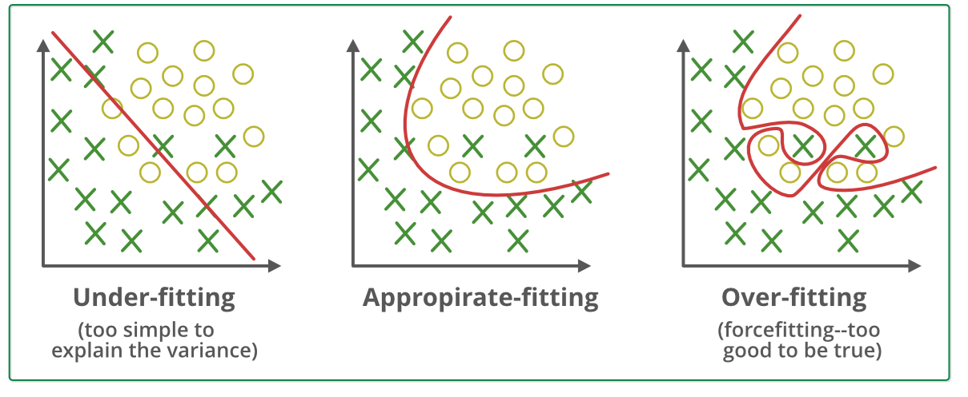
Last time: Over-fitting
Pooya Mohammadi Lecture 6 - 2 Winter-2020

Slide 3
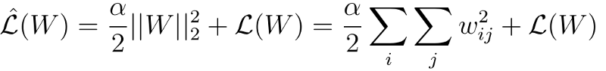
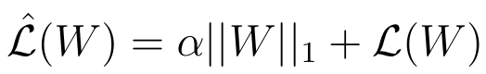
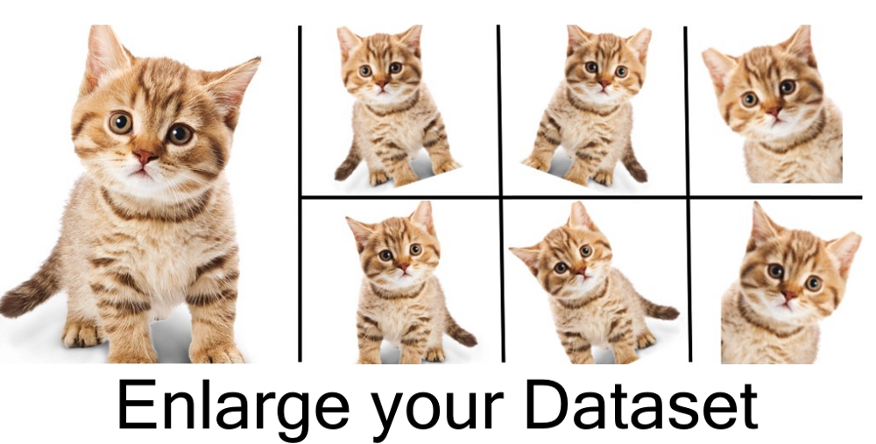
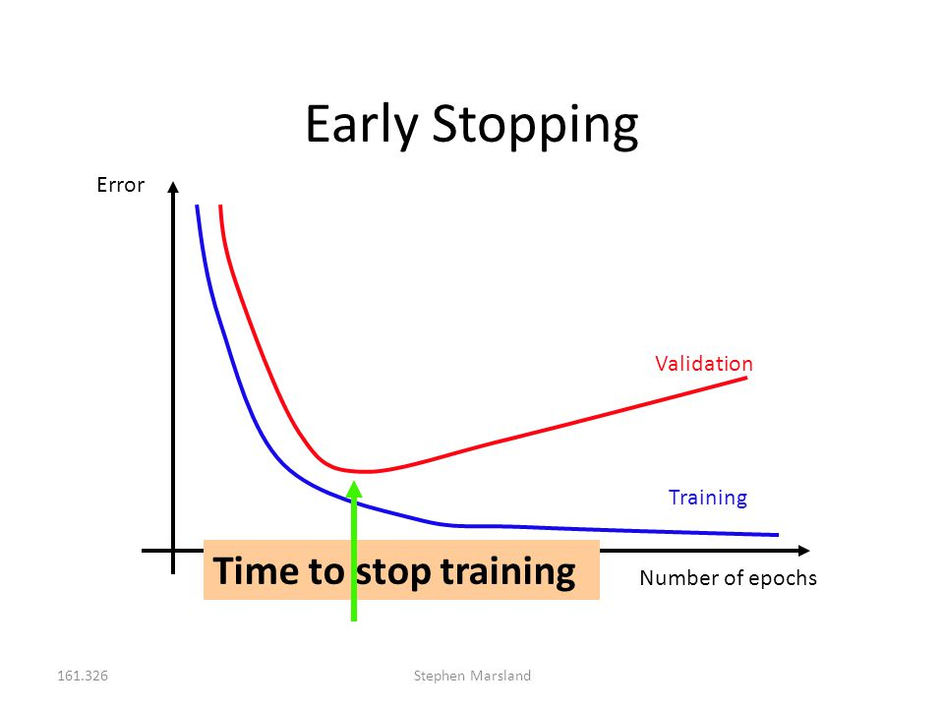
Last time: Regularization Techniques
L2:
L1:
Data Augmentation
Early Stop
Pooya Mohammadi Lecture 6 - 3 Winter-2020

Slide 4
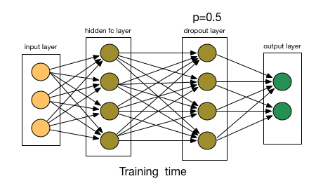
Last time: Dropout
Pooya Mohammadi Lecture 6 - 4 Winter-2020

Slide 5
Convolutional Neural Networks
Most material from Andrew NG’s Course at coursera
Pooya Mohammadi Lecture 6 - 5 Winter-2020

Slide 6
Today
Computer Vision Problems
Edge Detection
Padding
Stride
Convolution over Volume
Multiple Filters
Pooling Layer
Why Convolutions
Classic Architectures
LeNet-5
Alex-Net
VGG
Pooya Mohammadi Lecture 6 - 6 Winter-2020

Slide 7

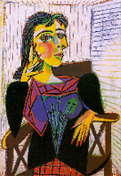
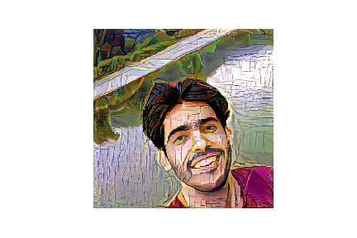
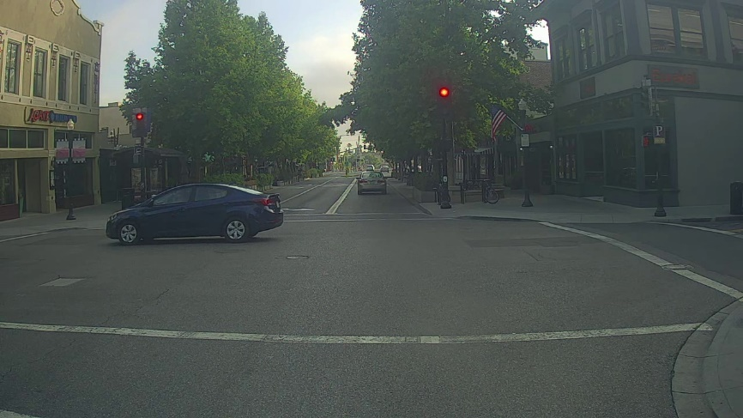
CNN: Computer Vision Problems
Image Classification
Neural Style Transfer
Cat? (0/1)
Object detection
Pooya Mohammadi Lecture 6 - 7 Winter-2020

Slide 8
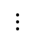
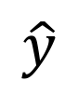
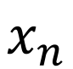
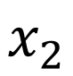
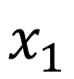
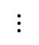
CNN: Deep Learning on large images
Cat? (0/1)
64x64
$$x_{1}$$
$$x_{2}$$
$$⋮$$
$$⋮$$
$$⋮$$
$$\hat{y}$$
$$x_{n}$$
Pooya Mohammadi Lecture 6 - 8 Winter-2020

Slide 9
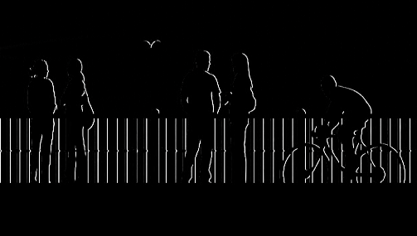
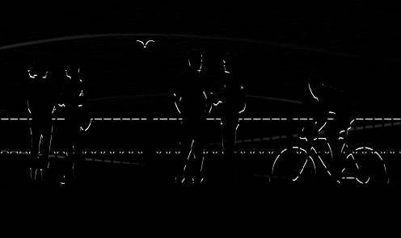
CNN: Computer Vision Problems
vertical edges
horizontal edges
Pooya Mohammadi Lecture 6 - 9 Winter-2020

Slide 10


CNN: Edge Detection(Convolving)
1
1
-1
0
1
1
0
-1
-1
-1
0
0
3 | 0 | 1 | 2 | 7 | 4
1 | 5 | 8 | 9 | 3 | 1
2 | 7 | 2 | 5 | 1 | 3
0 | 1 | 3 | 1 | 7 | 8
4 | 2 | 1 | 6 | 2 | 8
2 | 4 | 5 | 2 | 3 | 9
1
1
1
1
1
0
-1
0
-1
1
0
-1
1
1
0
-1
0
-1
-1
-1
-1
0
0
0
1 | 0 | -1
1 | 0 | -1
1 | 0 | -1
1
1
1
1
0
-1
0
0
-1
1
0
0
-1
-1
1
-1
1
0
-1
1
0
-1
0
-1
$$∗$$
$$=$$
1
0
-1
1
0
-1
1
1
0
-1
0
-1
0 | -2 | -4 | -7
-3 | -2 | -3 | -16
Formula:
Pooya Mohammadi Lecture 6 - 10 Winter-2020

Slide 11




CNN: Edge Detection(Vertical)
10 | 10 | 10 | 0 | 0 | 0
10 | 10 | 10 | 0 | 0 | 0
10 | 10 | 10 | 0 | 0 | 0
10 | 10 | 10 | 0 | 0 | 0
10 | 10 | 10 | 0 | 0 | 0
10 | 10 | 10 | 0 | 0 | 0
0 | 30 | 30 | 0
0 | 30 | 30 | 0
0 | 30 | 30 | 0
0 | 30 | 30 | 0
1 | 0 | -1
1 | 0 | -1
1 | 0 | -1
$$∗$$
$$=$$
$$∗$$
$$=$$
Pooya Mohammadi Lecture 6 - 11 Winter-2020

Slide 12

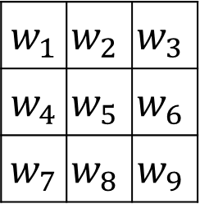

CNN: Learning how to detect edges
1 | 0 | -1
1 | 0 | -1
1 | 0 | -1
1 | 0 | -1
2 | 0 | -2
1 | 0 | -1
3 | 0 | -3
10 | 0 | -10
3 | 0 | -3
Sobel
Scharr
3 | 0 | 1 | 2 | 7 | 4
1 | 5 | 8 | 9 | 3 | 1
2 | 7 | 2 | 5 | 1 | 3
0 | 1 | 3 | 1 | 7 | 8
4 | 2 | 1 | 6 | 2 | 8
2 | 4 | 5 | 2 | 3 | 9
$w_{1}$ | $$w_{2}$$ | $$w_{3}$$
$w_{4}$ | $$w_{5}$$ | $$w_{6}$$
$w_{7}$ | $$w_{8}$$ | $$w_{9}$$
$$∗$$
$$=$$
Pooya Mohammadi Lecture 6 - 12 Winter-2020

Slide 13
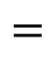

CNN: Padding
Problems:
Shrink output
Throw away information
1 | 3 | 2 | 1 | 3
2 | 9 | 1 | 1 | 5
1 | 3 | 2 | 3 | 2
8 | 3 | 5 | 1 | 0
5 | 6 | 1 | 2 | 9
1 | 0 | -1
1 | 0 | -1
1 | 0 | -1
$$∗$$
$$=$$
Formula:
Pooya Mohammadi Lecture 6 - 13 Winter-2020

Slide 14
CNN: Padding( Valid and Same )
“Valid”: No padding
“Same”:
Pad so that output size is the same as the input size.
Pooya Mohammadi Lecture 6 - 14 Winter-2020

Slide 15
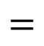

CNN: Stride
2 | 3 | 7 | 4 | 6 | 2 | 9
6 | 6 | 9 | 8 | 7 | 4 | 3
3 | 4 | 8 | 3 | 8 | 9 | 7
7 | 8 | 3 | 6 | 6 | 3 | 4
4 | 2 | 1 | 8 | 3 | 4 | 6
3 | 2 | 4 | 1 | 9 | 8 | 3
0 | 1 | 3 | 9 | 2 | 1 | 4
3
4
4
3
4
3
4
4
4
1
0
2
1
0
1
2
0
2
-1
0
3
4
4
91 | 100 | 83
69 | 91 | 127
44 | 72 | 74
-1
3
0
-1
3
4
4
3
0
3
3 | 4 | 4
1 | 0 | 2
-1 | 0 | 3
3
4
4
1
0
1
0
2
$$=$$
2
1
0
2
$$∗$$
-1
0
3
-1
0
3
4
4
3
-1
0
3
3
4
4
3
4
4
1
0
2
1
0
2
1
0
2
-1
0
3
-1
0
3
-1
0
3
Formula:
What about odd
Numbers?
Pooya Mohammadi Lecture 6 - 15 Winter-2020

Slide 16
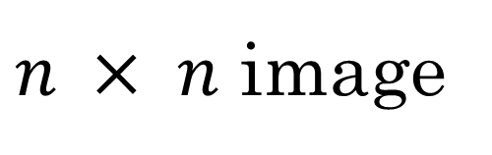
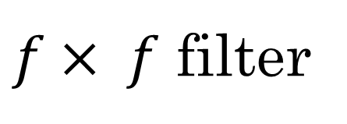
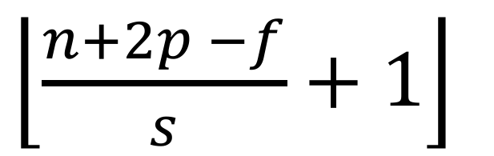
CNN: Summary of convolutions
$n × n$ image
$f× f$ filter
padding p
stride s
$\left\lfloor \frac{n+2p −f}{s}+1\right\rfloor$
$\left\lfloor \frac{n+2p −f}{s}+1\right\rfloor$
$$×$$
Pooya Mohammadi Lecture 6 - 16 Winter-2020

Slide 17


CNN: Convolutions over Volume (RGB image)
$$∗$$
$$=$$
3 x 3 x 3
4 x 4
1 | 0 | -1
1 | 0 | -1
1 | 0 | -1
0 | 0 | 0
0 | 0 | 0
0 | 0 | 0
0 | 0 | 0
0 | 0 | 0
0 | 0 | 0
6 x 6 x 3
Vertical edge detector in red channel
1 | 0 | -1
1 | 0 | -1
1 | 0 | -1
1 | 0 | -1
1 | 0 | -1
1 | 0 | -1
1 | 0 | -1
1 | 0 | -1
1 | 0 | -1
Vertical edge detector in any channel
Pooya Mohammadi Lecture 6 - 17 Winter-2020

Slide 18


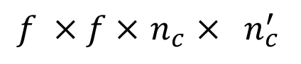

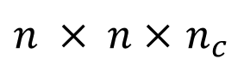


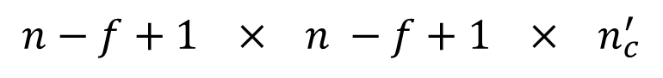
CNN: Multiple Filters
$$∗$$
$$=$$
3 x 3 x 3
4 x 4
$$∗$$
$$=$$
4 x 4 x 2
6 x 6 x 3
3 x 3 x 3
4 x 4
Formula:
$n × n×$ $n_{c}$
$$∗$$
$f ×f×$ $n_{c}$ $× n_{c}^{′}$
$$n−f+1 × n −f+1 × n_{c}^{′}$$
Pooya Mohammadi Lecture 6 - 18 Winter-2020

Slide 19




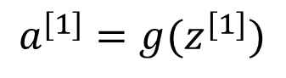
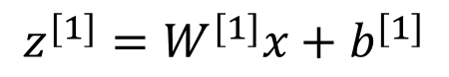
CNN: Example
$$∗$$
$$=$$
3 x 3 x 3
4 x 4
4 x 4
$$∗$$
$$=$$
6 x 6 x 3
3 x 3 x 3
4 x 4
4 x 4
$$z^{[1]}=W^{[1]}x+b^{[1]}$$
4 x 4 x 2
$$a^{[1]}=g(z^{[1]})$$
Pooya Mohammadi Lecture 6 - 19 Winter-2020

Slide 20
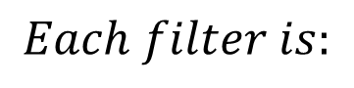
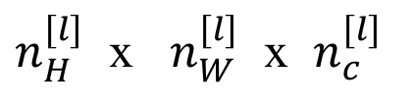
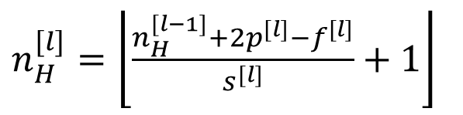
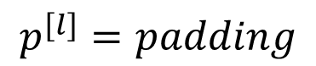
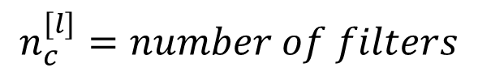
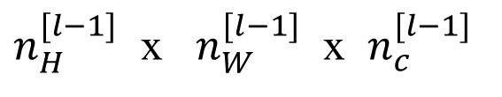
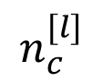
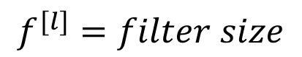
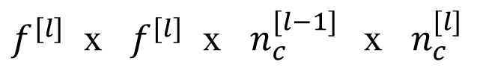
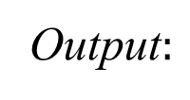
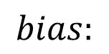
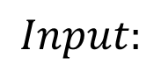
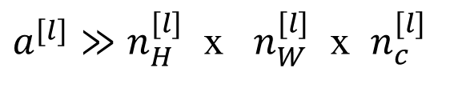
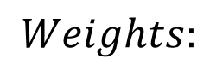
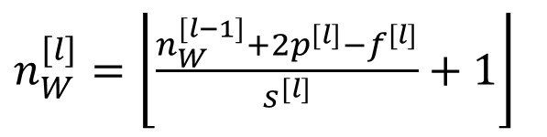
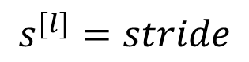
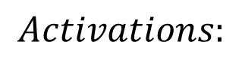
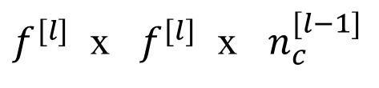
CNN: Summary of notations
If layer 1 is a convolution layer:
$$f^{[l]}=filter size$$
$$p^{[l]}=padding$$
$$Input:$$
$n_{H}^{[l−1]}$ x $n_{W}^{[l−1]}$ x $n_{c}^{[l−1]}$
$$s^{[l]}=stride$$
Output$:$
$n_{H}^{[l]}$ x $n_{W}^{[l]}$ x $n_{c}^{[l]}$
$$n_{c}^{[l]}=number of filters$$
$$Each filter is:$$
$f^{[l]}$ x $f^{[l]}$ x $n_{c}^{[l−1]}$
$n_{H}^{[l]}=\left\lfloor \frac{n_{H}^{[l−1]}+2p^{[l]}−f^{[l]}}{s^{[l]}}+1\right\rfloor$
$$Activations:$$
${a^{[l]}≫n}_{H}^{[l]}$ x $n_{W}^{[l]}$ x $n_{c}^{[l]}$
$n_{W}^{[l]}=\left\lfloor \frac{n_{W}^{[l−1]}+2p^{[l]}−f^{[l]}}{s^{[l]}}+1\right\rfloor$
$$Weights:$$
$f^{[l]}$ x $f^{[l]}$ x $n_{c}^{[l−1]} \text{x} n_{c}^{[l]}$
$$bias:$$
$$n_{c}^{[l]}$$
Pooya Mohammadi Lecture 6 - 20 Winter-2020

Slide 21
CNN: Question??
If you have 10 filters that are 3 x 3 in one layer of a convolutional neural network, which it’s input is an RGB image, how many parameters does that layer have?
Pooya Mohammadi Lecture 6 - 21 Winter-2020

Slide 22
CNN: Pooling Layer
Reduce the size of representation
Speed up computation
Makes some of features it detects a bit robust
Pooya Mohammadi Lecture 6 - 22 Winter-2020

Slide 23
CNN: Pooling Layer(Max pooling)
1 | 3 | 2 | 1
2 | 9 | 1 | 1
1 | 3 | 2 | 3
5 | 6 | 1 | 2
Hyper-parameters:
stride = 2
filter = 2
Note:
Max Pooling is done independently on each of the channels
Pooya Mohammadi Lecture 6 - 23 Winter-2020

Slide 24
CNN: Pooling Layer(Average pooling)
1 | 3 | 2 | 1
2 | 9 | 1 | 1
1 | 4 | 2 | 3
5 | 6 | 1 | 2
3.75
1.25
4
2
Pooya Mohammadi Lecture 6 - 24 Winter-2020

Slide 25
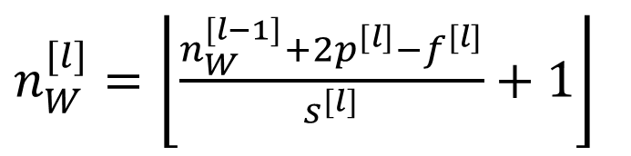
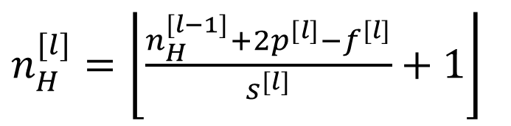
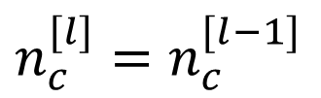
CNN: Pooling Layer(Summary)
Hyperparameters:
f : filter size
$n_{c}^{[l]}=$ $n_{c}^{[l−1]}$
s : stride
$n_{H}^{[l]}=\left\lfloor \frac{n_{H}^{[l−1]}+2p^{[l]}−f^{[l]}}{s^{[l]}}+1\right\rfloor$
Max or average pooling
$n_{W}^{[l]}=\left\lfloor \frac{n_{W}^{[l−1]}+2p^{[l]}−f^{[l]}}{s^{[l]}}+1\right\rfloor$
p : padding
Note:
Pooling Layer has no parameters to learn!!!
Pooya Mohammadi Lecture 6 - 25 Winter-2020

Slide 26
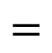

CNN: Why Convolutions
10 | 10 | 10 | 0 | 0 | 0
10 | 10 | 10 | 0 | 0 | 0
10 | 10 | 10 | 0 | 0 | 0
10 | 10 | 10 | 0 | 0 | 0
10 | 10 | 10 | 0 | 0 | 0
10 | 10 | 10 | 0 | 0 | 0
0 | 30 | 30 | 0
0 | 30 | 30 | 0
0 | 30 | 30 | 0
0 | 30 | 30 | 0
1 | 0 | -1
1 | 0 | -1
1 | 0 | -1
$$∗$$
$$=$$
Parameter sharing: A feature detector (such as a vertical edge detector) that’s useful in one part of the image is probably useful in another part of the image
Sparsity of connections: In each layer, each output value depends only on a small number of inputs
Pooya Mohammadi Lecture 6 - 26 Winter-2020

Slide 27
CNN: Why Convolutions
FC layer has no assumptions about input image
CNN assumes there is a local connection in input data
CNN is shift invariant
CNN has a lot few parameters
CNN Needs less training examples
CNN is less prone to over-fitting
Pooya Mohammadi Lecture 6 - 27 Winter-2020

Slide 28










Case Studies: LeNet-5
avg pool
avg pool
$$\hat{y}$$
k=5$×$ 5
s = 1
filters=6
f = 2
s = 2
k=5$×$ 5
s = 1
filters=16
f = 2
s = 2
$$⋮$$
$$⋮$$
32$×$32 $×$1
28$×$28$×$6
14$×$14$×$6
10$×$10$×$16
5$×$5$×$16
120
84
[LeCun et al., 1998. Gradient-based learning applied to document recognition]
Pooya Mohammadi Lecture 6 - 28 Winter-2020

Slide 29


Case Studies: LeNet-5
Notes:
No padding
Small Network >>> 60k parameters
No ReLU
$n_{h} ,n_{w} decrease and n_{c} increases$
Avg pool
$conv pool conv pool fc fc ouput$
[LeCun et al., 1998. Gradient-based learning applied to document recognition]
Pooya Mohammadi Lecture 6 - 29 Winter-2020

Slide 30
Work Flow
Preprocess the input data(Scaling, reshaping, and …)
Design a model(LeNet-5, AlexNet, and …)
Compile the model(define optimizer, loss function, and metrics)
Plot your architecture and save the figure
Fit the model(define training dataset, batch size, epochs, validation data, and …)
Prevent the model from Over-fitting(Dropout, L2, and …)
Draw the loss and metrics’ history for the training and validation datasets
Predict 5 random images from the test dataset, plot the images and print the top 5 probabilities for each plotted image
Save the model and the model weights…
Pooya Mohammadi Lecture 6 - 30 Winter-2020

Slide 31




















Case Studies: AlexNet
MAX-POOL
MAX-POOL
11$×$ 11
s = 4
filters=96
3$×$ 3
s = 2
5$×$ 5
same
filters=256
3$×$ 3
s = 2
55$×$55 $×9$6
27$×$27 $×$96
27$×$27 $×$256
13$×$13 $×$256
227$×$227 $×$3
MAX-POOL
=
3$×$ 3
same
filters=384
3$×$ 3
same
filters=384
3$×$ 3
same
filters=256
3$×$ 3
s = 2
$$⋮$$
$$⋮$$
$$⋮$$
Softmax
1000
13$×$13 $×$384
13$×$13 $×$384
13$×$13 $×$256
6$×$6 $×$256
9216
4096
4096
[Krizhevsky et al., 2012. ImageNet classification with deep convolutional neural networks]
Pooya Mohammadi Lecture 6 - 31 Winter-2020

Slide 32
Case Studies: AlexNet
Notes:
Similar to LeNet-5 but much bigger >>> 60M parameters
SGD Momentum 0.9
First use of ReLU
Learning rate 1e-2 , reduced by 10 manually when val accuracy plateaus
Used Norm layers(not common anymore)
L2 weight decay 5e-4
Heavy data augmentation
7 CNN ensemble: 18.2% -> 15.4%
Dropout 0.5
[Krizhevsky et al., 2012. ImageNet classification with deep convolutional neural networks]
Pooya Mohammadi Lecture 6 - 32 Winter-2020

Slide 33


















Case Studies: VGG-16
CONV = 3$×$3 filter, s = 1, same
MAX-POOL = 2$×$2 , s = 2
224$×$224$×$64
112$×$112 $×$64
112$×$112 $×$128
56$×$56 $×$128
[CONV 64]
$×$2
POOL
[CONV 128]
$×$2
POOL
224$×$224 $×$3
56$×$56 $×$256
28$×$28 $×$256
28$×$28 $×$512
14$×$14$×$512
[CONV 256]
$×$3
POOL
[CONV 512]
$$×3$$
POOL
14$×$14 $×$512
7$×$7$×$512
FC
FC
Softmax
[CONV 512]
$×$3
POOL
4096
4096
1000
[Simonyan & Zisserman 2015. Very deep convolutional networks for large-scale image recognition]
Pooya Mohammadi Lecture 6 - 33 Winter-2020

Slide 34

Case Studies: VGG-16
Notes:
$Simple architecuture$
No Local Response Normalization(LRN)
$n_{h} ,n_{w} decrease by factor of two$
Use VGG16 or VGG19(VGG19 only slightly better, more memory)
$n_{c} increases by factor of two$
Use ensembles for best results
$138M parameters$ :(
FC7 features generalize well to other tasks
$ILSVRC^{′}14 2nd in classification, 1st in localization$
[Simonyan & Zisserman 2015. Very deep convolutional networks for large-scale image recognition]
Pooya Mohammadi Lecture 6 - 34 Winter-2020

Slide 35
Case Studies: VGG-16
Question??
Why use smaller filters? (3x3 conv)
Stack of three 3x3 conv (stride 1) layers has same effective receptive field as one 7x7 conv layer
But deeper, more non-linearities
And fewer parameters: 3 *(3*3*C*C) vs. 7*7*C*C for C channels per layer
Pooya Mohammadi Lecture 6 - 35 Winter-2020

Slide 36
Questions??
Pooya Mohammadi Lecture 6 - 36 Winter-2020

